Slide 1
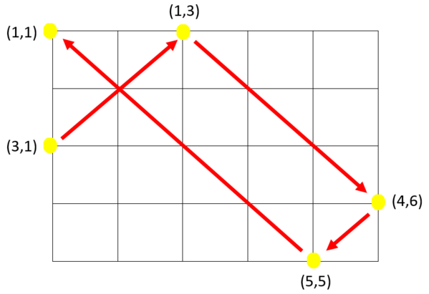
I2P mid practice – Light Reflection
Simulate light reflection, and print the k-th reflection point.
size of room = Height ∗ Width
starting point = (r , 1)
angle of incidence = 45°
The light will stop if it hits any corner of the room.
1st point = (3 , 1)
2nd point = (1 , 3)
3rd point = (4 , 6)
.
.
.
k-th point = ???

Slide 2
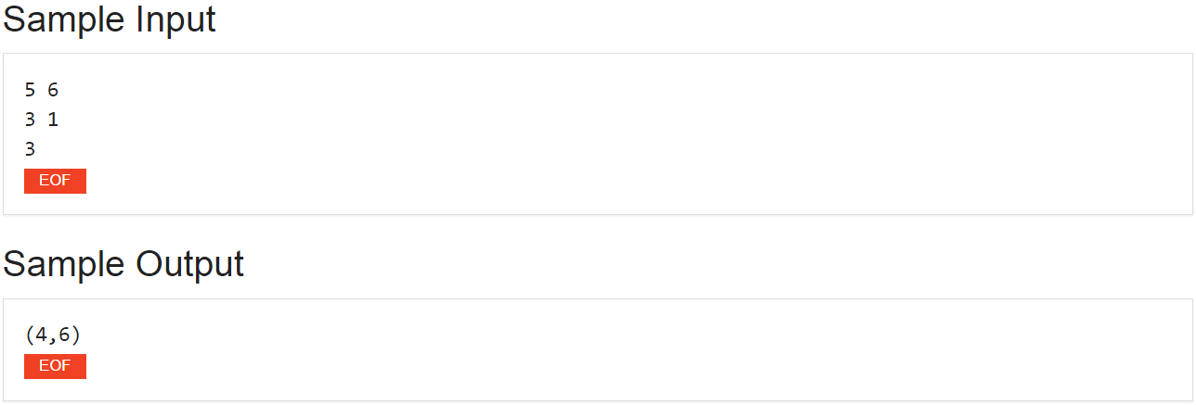
Sample Input / Sample Output
“Height” and “Width” of the room
“Coordinate” of starting point
“k-th” reflection
“coordinate” of the k-th reflection point

Slide 3
Step 1: Read in starting point
int count=0;
/*(row,col) is the 1st point*/
scanf("%d%d", &row, &col);
count+=1;
Starting point
(row , col)

Slide 4
Different reflection situations
/* Initial incidence direction is upper-right (direction==1).*/
int direction=1;
Possible situations for incidence directions: 1. upper-right (direction==1):
Case 1
Case 2

Slide 5
Different reflection situations (Cont.)
2. lower-right (direction==2)
3. lower-left (direction==3)
4. upper-left (direction==4)

Slide 6
Step 2: Handle possible cases for direction==1
for(; count<k; count++) {
……
if(direction==1) {
while(1) {
row--; col++;
if(row==1) {
direction = 2; //lower-right
break;
}
else if(col==W) {
direction = 4; //upper-left
break;
}
}
/*other situations……*/
}
Case 1
//upper-right
4
1
Case 2
3
2

Slide 7
Step 3: Handle remaining reflection situations
for(; count<k; count++) {
……
/*situations for direction=2, 3, 4*/
else if(direction==2){
……
}
else if(direction==3){
……
}
else if(direction==4){
……
}
}

Slide 8
Step 4: Handle corner situations
for(; count<k; count++) {
/*If the light hits the corner, break from the for loop.*/
if((row==1 || row==H) && (col==1 || col==W)) break;
/* situations for direction=1, 2, 3, 4 */
……
}

